Slide 1

Cybersecurity: Making Your Library Defensible and Resilient
Blake Carver
Senior Systems Administrator, LYRASIS
April 2021
Cybersecurity Training for Libraries
Week #3
Notes:
Include a Title Slide

Slide 2

This project was supported in whole or in part by the U.S. Institute of Museum and Library Services under the provisions of the Library Services and Technology Act, administered in California by the State Librarian. The opinions expressed herein do not necessarily reflect the position or policy of the U.S. Institute of Museum and Library Services or the California State Library, and no official endorsement by the U.S. Institute of Museum and Library Services or the California State Library should be inferred.
Notes:
This is a quick FYI that this workshop is part of a project supported by the Library Services and Technology Act, so thank you to the grant authority for providing resources for this project. You can find this statement in the slide handouts as well.

Slide 3
Today’s Schedule
10:00 – 10:20 Welcome & course housekeeping
10:20 – 10:45 Training
10:45 – 10:50 Break
10:50 – 11:25 Training
11:25 – 11:30 Wrap up
Notes:
This cybersecurity train the trainer webinar series runs on Wednesdays from 10 to 11:30. Each week we’ll try to keep close to the schedule posted in the slide. There will be some time for Q&A at the end of the session, so if any questions pop up during the presentation, you can enter them in the chat box so we can answer them then.

Slide 4
Outline
Week One – Welcome – Explanations of why and what’s wrong
Touch on some privacy issues.
Why are libraries, and all of us, targets?
Why is security important?
Professionals and Incentives, big money.
What are they after and where are they working?
Passwords
Week Two – Securing our things
Passwords
What things do we have to secure?
Hardware, software, etc
How do things actually get infected? How can we spot it?
Email, phishing, browsers, VPNs, Tor, desktop, mobile, everything else.
Week Three - Making Your Library Defensible & Resilient
What and why of things around the library
Hardware, networks, ransomware
Week Four – Wrapping It All Up
Training, planning, vendors
Websites
Checklists and specific steps to take next.
Notes:
This week we are starting off with an overview of libraries and data privacy. For those of you who too last year’s training, this should be a refresher. Week two is where we get into library privacy training, including training development and ways of supporting staff outside of training. Week three goes back into library operations with three main topics that go beyond basic data privacy training, including risk assessment and patron programming. Week Four brings everything together to focus on building a culture of privacy in all areas of the library, including what to do after the series.

Slide 5
Making Your Library Defensible & Resilient

Slide 6
Able To Be Defended
Defensible does not mean secure
There are more things to defend than there are resources to defend with
Defensibility focuses on what, why, how, when and from whom

Slide 7
Defensible
A change in mindset
Awareness of limitations & weaknesses
Awareness of threats
An admission of inconvenience
A lot of hard, detailed work.

Slide 8
Cyber Resilience
Your ability to keep operating when bad things happen to your IT.
The ability to withstand all types of cyber events.
Prevention
Detection
Containment
Response

Slide 9
What's security?
Gets in the way for patrons & fails for administrators
For us, it's critical
So it's important for us to remember what others think
We need to keep in mind how security affects users

Slide 10
What's security?
This is more than just tech, it's about
People
Processes
Technology
In the end, we want to have trained people using solid technology
We can't afford a security team, or even a person, we can't afford a databareach or ransomware either

Slide 11
“Security is always excessive until it’s not enough.”
Robbie Sinclair, Head of Security, Country Energy, NSW Australia

Slide 12
We’ve been thinking…
What do we have to secure?
Who wants it?
How could they acquire it?
How could they benefit from its use?
  Can they sell it?
  Can they hold it hostage?
  Can they use & abuse it?
How damaging would the loss of data be?
How would this change operations?
How secure do we really need to be?
Notes:
There's something called "Threat Modeling" in IT Security. I like to think of it as just taking a step back and looking at the big picture.
It doesn't necessarily take an expert, but it takes time, and patience and some training.
In libraries, it helps us align our limited resources, work, money, defenses with the threats that pose the greatest risk. That is, those threats that are the most likely to occur and those that could be the hardest to recover from.
Our risks need ranking, and working through some Threat Modeling lets us do that. Sure, we need to lower all risks, but all risks aren't equal. We want to know what our biggest threats are. Those that are likely to be attacked and those that are easy to be exploited. What's most valuable and hardest to recover from. We need to make sure we know what's around and how it can be exploited.
Where do we focus? Where do we even start. It's probably not easy, and looks overwhelming. We need to find ALL the things to defend and decide how to best defend them. Then, take a look at what we have and rank them. All those things on your list are not equal. Start with the highest risks. The things most easily exploited. The most valuable things.
We have limited time/people/money we need to have priorities because there is SO much to worry about, so we need to know our threats RANKED and how we're going to defend them. We want to make sure we're able to focus what we have in the right place, and that's what this is about. Going from overwhelmed, to a starting point, a place to focus. All the many threats we face are not equally dangerous, and our defenses are not all equal. A good starting point is knowing what's been hit before. What caused that breach/exploit/hack (Patches, social engineering, passwords, misconfiguration).
How do we rank all these things?
What do we have to protect?
Everything with an IP
Everything isn't equal
How likely is each thing to be attached?
It's been attacked before?
Common Device?
Attack surface?
Easy to run common tools to test for exploits?
how easy is this thing to find/exploit?
Does it contain PII or CC#s or anything that can be sold?
Has it ALREADY been exploited in this OR another library?
Can people touch this thing?
Work up scenarios.
How hard is this thing to defend?
Replace with another thing?
How much work is involved?
Work up scenarios.
Who is going to attempt to attack it?
Location? Remote / Local?
Capabilities? Talented / Beginner?
Bot / Automated / Human?
Work up scenarios.
What happens when it is compromised?
What do you lose?
How hard to recover?
How much damage?
How many people are impacted?
How important is this thing?
Work up scenarios.
Let's not over look people!
Training / Planning
Can they rank threats?
Do they know the top 5 threats? ANY threats?
So now what?
- Research & Learn
- Collect & count
- Rank
- Plan
- Put defenses in place
- Train
- Review
- Repeat
12

Slide 13
What’s Plugged In?
It’s important to know what you have & when it should be renewed
Identifying your assets needs to be a regular exercise
Shadow IT, forgotten things, outdated things, you need to know what’s around the library.
Knowing what you have will hopefully lead to getting new stuff.
Getting new stuff is important from a security standpoint.
How’s that budget looking!?
Are cloud hosted things better at being updated? You don’t host it, you don’t need to update it?
Our risk tolerance keeps getting higher because we can’t afford to buy new stuff. Keep putting it off.
There's always a good reason to put it off
cost, time, expertise, capability, influence (how do YOU influence it to get done)

Slide 14
Change Management
When a business begins to use a change information resource (software, hardware, networks, system documentation, and operating procedures and environment) for any reason, it should be managed according to a specific process called a “control process” fixed in advance so that the transition is accomplished in an organized way in all its steps from the review to the authorization, test, implementation, and release of the changed resource.
In addition to the change management procedures, the control process should assign responsibilities and authorities to all the business staff involved.
https://resources.infosecinstitute.com/certification/change-management-cissp/

Slide 15
Think Like A Bad Guy
What useful information can I see about a target from the outside? (Enumerability)
How valuable is this asset to the adversary? (Criticality)
Is the asset known to be exploitable? (Weakness)
How hospitable will this asset be if I pwn it? (Post-exploitation potential)
How long will it take to develop an exploit? (Research potential)
Is there repeatable ROI developing an exploit? (Applicability)
https://threatpost.com/6-questions-attackers-ask-exploit/162651/
Notes:
David “moose” Wolpoff at Randori explains how hackers pick their targets, and how understanding “hacker logic” can help prioritize defenses.
In the past decade or so, we’ve seen a massive shift toward the cloud. The COVID-19 pandemic and associated pivot to remote work has only accelerated this cloud trend, forcing blue-teamers to be more agile to protect their attack surfaces. While defenders are adapting to support cloud-based environments, attacks against cloud systems have increased by 250 percent in the last year.
More assets in the cloud creates challenges for defenders, but it’s wrong to assume that this makes things easier for an adversary. Attackers don’t have time to look at every asset in depth — the number of which can run in the tens of thousands for a large enterprise. Just as there are demands on security teams, adversaries have constraints. Their time has a cost, they must operate within limited budgets and their technical capabilities have an upper boundary.
As a person who’s been hired by hundreds of CISOs to test their defenses with a red-team engagement, I’m well aware that defenders are buried in security alerts, struggling to find the right signals among the noise. These teams have dozens of security applications, checklists and a pile of processes to execute defensive strategies. Yet, a massive gap between how a blue-teamer defends and how an attacker attacks exists. Understanding the opponent — the hacker’s logic — is a solid first step to decoding the signals that matter and closing that gap. The attacker’s perspective on how an attacker evaluates assets to go after and exploit on an attack surface begins by answering six questions. And, if this logic is applied in the enterprise, its security strategy will shift, leading to more efficiencies and lower risk.
What useful information can I see about a target from the outside? (Enumerability)
Every target in an attack surface has a story to tell, some in more detail than others. Ultimately, the more information an attacker can gather about a piece of technology used (or about a person in an organization), the more confidently they can plan a next phase of attack, so they can more confidently invade a network. The unraveling of details about a target describes enumerability — how finely an attacker can detail a target from the outside. For example, depending on the service and its deployment, a web-server target could report anything from no server identifier to the specific server name — “Apache” or “Apache 2.4.33.” If attackers can see the exact version of a service in use and its configuration, they can run precise exploits and attacks, maximizing chances of success and minimizing odds of detection.
How valuable is this asset to the adversary? (Criticality)
Every step a hacker takes is effort, time, money and risk. It’s better to knock on doors that lead somewhere than to fumble at targets randomly. Some targets are just more likely to lead somewhere than others because their very purpose makes them a juicy target. Attackers assess criticality before acting, in order to focus their efforts on targets that are likely to lead them closer to their objectives. Security appliances like VPNs and firewalls, or remote-support solutions on the perimeter, are proverbial keys to the kingdom — compromising one can open a path to the network, and to credentials that would allow for greater network access. Likewise, credential stores and authentication systems can give the attacker more credentials if compromised. Attackers seek tools that provide the best positioning and access. Exposed assets that don’t protect, and won’t lead to, critical data or access are just less valuable to hackers.
Is the asset known to be exploitable? (Weakness)
Contrary to popular belief, having a high severity CVSS ranking on the CVE list doesn’t automatically mean a target is of great interest to an attacker. There have been many “critical, wormable, world-ending, fire-and-brimstone” vulnerabilities that weren’t actually exploitable. Even more bugs are exploitable, but only in really specific circumstances. Some may be perfectly exploitable in theory, but nobody has actually done the work to do it. Attackers must consider the cost and likelihood of actually pwning an asset. If a useful proof-of-concept (POC) exists, that is a good indicator. If there’s lots of research and analysis about a specific vulnerability, exploitation might not be a question, it might just be work. Time is money, and exploits take time, so a hacker has to consider the tools available in public, the tools they can afford to build or tools they could buy (think Canvas or Zerodium). For a specific asset, in certain cases, adversaries buy previously-built exploits. This happens a lot more than many realize.
How hospitable will this asset be if I pwn it? (Post-exploitation potential)
An attackers’ definition of a “hospitable environment” is one that makes it possible to live in and travel through, undetected. This is an asset where malware and pivoting tools work and where few defenses exist. This target is one that blue teams just cannot install any defenses on, so the attacker knows they can operate with little worry of being detected. Any technology that is sufficiently protected and monitored — like endpoints — are not hospitable. Desktop phones and VPN appliances, and other unprotected hardware devices that are physically plugged into the network and have familiar execution environments, make a great host. Many appliances are built with Linux and come with a complete userspace and familiar tools pre-installed, making them a target that has high post-exploitation potential.
How long will it take to develop an exploit? (Research potential)
Knowing you’d like to attack a particular target, and actually having some exploit or technique to do so, aren’t the same thing. When looking at a particular target, a hacker has to assess how likely they are to succeed in developing a new exploit, and at what cost. Vulnerability research (VR) isn’t just for finding stuff to patch. Hackers do VR on targets because they want to exploit. The cost of that research, along with the cost of testing and polishing any resulting tools, is a part of assessing if a target is worth attacking. Well-documented, well researched or open-source tools that can easily be obtained and tested are easier targets. Expensive and esoteric platforms (usually hardware like VoIP systems or those absurdly expensive security appliances) call for special skills and resources to attack (even though they’re attractive because of value of data stored and level of access granted). Any barriers to entry limit adversaries’ incentives to target specific platforms, tools or services.
Is there repeatable ROI developing an exploit? (Applicability)
One of the biggest shifts from defender mindset to hacker logic is understanding attackers’ business models. Attackers invest time, research and human capital creating exploits and building tools. They want the highest possible ROI. Your organization is most likely one of many a hacker is interested in, because your adversary wants to spread their costs over many victims at once. Attackers assess applicability to understand the potential to create and use an exploit beyond a single instance. With limited resources, attackers create exploits for widely-used technologies that create high earning potential across multiple targets. Remember when Macs were seen as unhackable? At the time, Microsoft had more market share, so exploiting Windows was more profitable. As Windows becomes a harder target, and Macs proliferate in the enterprise, that changes. Likewise, iOS vulnerabilities were far more expensive than Android bugs. But market forces are driving iOS vulnerabilities to be more common and less expensive (relatively).
Attackers don’t look at the severity of a bug and decide what to attack. There are many more components in planning an individual action, nevermind the long strings of actions that are part of an attack. Attackers have to manage resources while trying to achieve their objective, or indeed operate, their business. This idea that adversaries make tradeoffs too is one defenders should take to heart. In defending a business, it’s not possible to protect everything, everywhere, from all adversaries, all the time. Compromise is inevitable. The name of the game in risk management is placing defensive bets in the best ways possible to optimize a business outcome. Thinking more like an attacker can shape prioritization, and highlight the assets that are both valuable and tempting to adversaries, making it possible for businesses to decide, sometimes, that the cost of truly hardening a target just isn’t worth the benefit.
David “moose” Wolpoff, is co-founder and CTO at Randori.
Enjoy additional insights from Threatpost’s InfoSec Insider community by visiting our microsite.

Slide 16
But We’re Just A Small Library!
Notes:
You might say to yourself, oh, we’re just a library, no one will come after us, we have nothing worth taking.

Slide 17
You can’t assume no one cares about what is in your library

Slide 18
We (libraries) are targets because we're large (ish) and complex (ish) and hard to defend, often we are part of larger organizations, (city/county, campus), and those other things could have way more than just the library that's way more valuable

Slide 19
83% targets of opportunity
92% of attacks were easy
85% were found by a 3rd party
Every Single Security Report Ever
Notes:
A conclusion reinforced by evidence accrued in the aforementioned Verizon report and the following summation by Marc Spitler, a Verizon security analyst:
"Very often, the companies breached had no firewalls, had ports open to the Internet or used default or easily guessable passwords."
In other words, easy-to-find, easy-to-learn and easy-to-exploit weak passwords.
Victims were not ‘chosen’ because they were large, important or had financial data. They were simply the easiest targets.
“Every year that we study threat actions leading to data breaches, the story is the same; most victims aren’t overpowered by unknowable and unstoppable attacks. For the most part, we know them well enough and we also know how to stop them.”
And here’s the same thing in different wording:
“The latest round of evidence leads us to the same conclusion as before: your security woes are not caused by the lack of something new. They almost surely have more to do with not using, under using, or misusing something old.”
And of course, I like this one because it highlights Automated Vulnerability Assessment:
“SQL injection attacks, cross-site scripting, authentication bypass, and exploitation of session variables contributed to nearly half of breaches attributed to hacking or network intrusion. It is no secret that attackers are moving up the stack and targeting the application layer. Why don’t our defenses follow suit? As with everything else, put out the fires first: even lightweight web application scanning and testing would have found many of the problems that led to major breaches in the past year.”
Basically, your organization already has the security solution that it needs; you’re just not using it.

Slide 20
It’s Easier Being Bad
Notes:
As you’ve now seen, it takes very very little skill to be a bad guy now.

Slide 21
Security Is More Difficult
Notes:
Why Security Is Hard
Though it is easy, that is, so many of the holes we miss are easy to fill, it’s hard to get it all right.
IT Security isn't always easy. When it comes to securing your IT resources it's very easy to make a mistake, or overlook something small. In every library it feels like there are a million things to worry about. It's NOT only the fools who are getting hacked, it's everyone and anyone. The best of us miss things and make mistakes that can lead to security breaches. Most libraries don't have the money, time, or people to secure even the small number of resources they have. Larger libraries may be able to afford to spend more time/money on security, but then they also have more things to secure. Unfortunately, security doesn't scale up very easily. This doesn't mean you should give up and hope for the best! Everyone in your library has some small part to play in keeping things secure. We can talk all day about how we should integrate security into our daily routine more, and how vendors need to simplify, consolidate, and improve functionality. But in the end those problems are every bit as hard as everything else I'm talking about and won't be solved anytime soon. Especially since the economics or security aren't overly favorable. The costs are very low for the bad guys, and very high for those of us trying make things more secure.
The malware your computers are subject to now is very sophisticated. It's highly evolved and many times will be able to run totally undetected. It has automated installers, updaters, and a sophisticated command and control center that puts every infected machine to good use. It's easy for the writers of these tools to stay one step ahead of those who work to keep us safe. It's very easy for your computers to spy on your users, or become part of a botnet used to cause trouble anywhere in the world.

Slide 22
The attacker only needs to succeed once…
or just keep trying
Notes:
Force Attacker Perfection
I will fully admit that I sometimes finding myself parroting standard industry tropes. For example, I can’t recall how many times I’ve said in presentations and interviews:
The defender needs to be perfect all the time. The attacker only needs to succeed once.
And yes, it’s totally true. But we spend so much time harping on it that we forget how we can turn that same dynamic to our advantage.
If all the attacker cares about is getting in once, that’s true. If we only focus on stopping that first attack, it’s still true. But what if we shift our goal to detection and containment? Then we open up some opportunities.
As defenders, the more barriers and monitors we put in place, the more we demand perfection from attackers. Look at all those great heist movies like Ocean’s 11 – the thieves have to pass all sorts of hurdles on the way in, while inside, and on the way out to get away with the loot.
We can do the same thing with compartmentalization and extensive alert-based monitoring. More monitored internal barriers are more things an attacker needs to slip past to win. Technically it’s defense in depth, but we all know that term has turned into an excuse to buy more useless crap, mostly on the perimeter, as opposed to increasing internal barriers.
I am not saying it’s easy. Especially since you need alert-based monitors so you aren’t looking at everything by hand. And let’s be honest – although a SIEM is supposed to fill this role (at least the alerting one) almost no one can get SIEM to work that way without spending more than they wasted on their 7-year ERP project. But I’m an analyst so I get to spout out general philosophical stuff from time to time in hopes of inspiring new ideas. (Or annoy you with my mendacity).
Stop wishing for new black boxes. Just drop more barriers, with more monitoring, creating more places for attackers to trip up.
—Rich

Slide 23
While we need to catch every single thing...
Notes:
Force Attacker Perfection
I will fully admit that I sometimes finding myself parroting standard industry tropes. For example, I can’t recall how many times I’ve said in presentations and interviews:
The defender needs to be perfect all the time. The attacker only needs to succeed once.
And yes, it’s totally true. But we spend so much time harping on it that we forget how we can turn that same dynamic to our advantage.
If all the attacker cares about is getting in once, that’s true. If we only focus on stopping that first attack, it’s still true. But what if we shift our goal to detection and containment? Then we open up some opportunities.
As defenders, the more barriers and monitors we put in place, the more we demand perfection from attackers. Look at all those great heist movies like Ocean’s 11 – the thieves have to pass all sorts of hurdles on the way in, while inside, and on the way out to get away with the loot.
We can do the same thing with compartmentalization and extensive alert-based monitoring. More monitored internal barriers are more things an attacker needs to slip past to win. Technically it’s defense in depth, but we all know that term has turned into an excuse to buy more useless crap, mostly on the perimeter, as opposed to increasing internal barriers.
I am not saying it’s easy. Especially since you need alert-based monitors so you aren’t looking at everything by hand. And let’s be honest – although a SIEM is supposed to fill this role (at least the alerting one) almost no one can get SIEM to work that way without spending more than they wasted on their 7-year ERP project. But I’m an analyst so I get to spout out general philosophical stuff from time to time in hopes of inspiring new ideas. (Or annoy you with my mendacity).
Stop wishing for new black boxes. Just drop more barriers, with more monitoring, creating more places for attackers to trip up.
—Rich

Slide 24
“In security, you almost never go from making something possible to impossible... You go from making it easy to making it hard...”
We want to make things hard on the bad guys.
https://www.propublica.org/article/solarwinds-cybersecurity-system

Slide 25
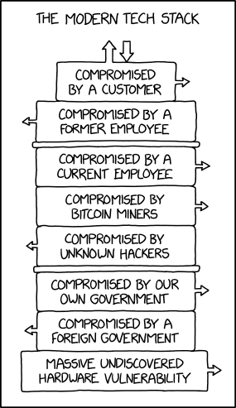
https://xkcd.com/2166/

Slide 26
Libraries Live Below
The Security Poverty Line
(Wendy Nather)
We simply can't afford to reach a great level of security
Few or no IT People
Few or no Security People
Hard to keep up with technology and security
Maintenance, planning, strategy are 2nd to OMG
Depend on consultants, vendors, family, patrons, friends, volunteers, etc...
Notes:
http://idoneous-security.blogspot.com/2011/12/security-poverty-line-and-junk-food.html
26

Slide 27
Staying safe takes more than just a firewall & AV/AM...
Notes:
If firewalls worked that list of the major data breaches wouldn’t exsist.

Slide 28












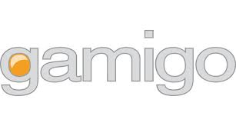


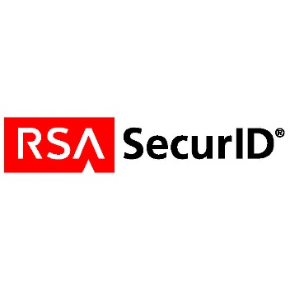

Notes:
A bunch of places that have suffered recent large databreaches. Just a few of many

Slide 29
Your security software / hardware is a seat belt – not a force field.
Notes:
http://www.wired.com/wiredenterprise/2012/03/antivirus/
Jeremiah Grossman is the kind of guy you’d expect to be super paranoid when it comes to computer security. He was on the front lines at Yahoo more than a decade ago when a hacker named MafiaBoy was abusing the site with DDoS attacks. Now Chief Technology Officer at security consultancy White Hat Security, Grossman spends his time fighting web intruders for his company’s clients.
When it comes to computer security, he’s paranoid — and for good reason. He’s seen what the bad guys can do. But when he met with Wired at the RSA Conference in San Francisco this week, he said something surprising: He doesn’t use antivirus software.
As it turns out, many of his security-minded peers don’t use it either. The reason: If someone is going to try and attack them, they’re likely to use a new technique, one that most antivirus products will miss. “If you asked the average security expert whether they use antivirus or not,” Grossman says “a significant proportion of them do not.”
Dan Guido, the CEO of security startup Trail of Bits also doesn’t use AV. Some security pros use it because they’re in regulated industries, or because they work with customers who require it. “If it weren’t for that,” he says, “almost nobody in the security industry would run it.”
It’s a story we heard again and again at RSA this week. The pros are generally smart enough to avoid the things that will get them hacked — visiting malicious websites or opening documents from untrusted sources. But even if they get fooled, the odds are their antivirus software catching it are pretty low. But many of these pros also believe that antivirus isn’t always that useful to the average business either.
“Ten years ago if you were to ask someone the question, ‘Do you need antivirus?’ the overwhelming response would be, ‘Absolutely, my entire security strategy is based on endpoint antivirus,’” says Paul Carugati, a security architect with Motorola Solutions. “Today … I don’t want to downplay the need for it, but it has certainly lost its effectiveness.”
The problem is that most criminals are smart enough to test their attacks against popular antivirus products. There’s even a free website called Virus Total that lets you see whether any of the most popular malware scanning engines will spot your Trojan program or virus. So when new attacks pop up on the internet, it’s common for them to completely evade antivirus detection.
Consumers and small businesses can get good antivirus software for free, but do businesses even need antivirus software?
You Do and You Don’t
The short answer is: yes they do. Most companies can’t just drop AV. First of all, it’s a line of defense protecting employees who do the stupid things that the security experts tell us to avoid: clicking on dubious attachments, visiting untrustworthy websites. Second, companies often must have desktop security software to meet industry regulations, such as the Payment Card Industry (PCI) Data Security Standard. Those folks simply have no choice but to pay the Symantecs and McAfees of the world.
But according to some, businesses should probably spend less on antivirus and other security software. Much of the money they’re spending is better spent somewhere else, such as analyzing the mountains of data logged by software on computer networks for signs of attack. “Save that money,” says Andy Ellis, Chief Security Officer with Akamai, a company that helps websites deliver content on the internet. “Do your own log analysis because that is what’s going to catch the problems.”
White Hat’s Grossman agrees. “I think we overspend on the wrong security products,” he says. “Particularly antivirus. I think we overspend on firewalls and antivirus.”
Corporations do spend a lot of money on antivirus and firewalls. Research firm Gartner pegs the corporate desktop security software market at $3.4 billion worldwide. Consumers will spend even more — nearly $5 billion — on antivirus this year. Biggest of all, though, is the $6.5 billion firewall market.
Gartner Analyst Ruggero Contu doesn’t quite buy the argument that companies are spending too much money on antivirus. According to him, the antivirus vendors have been doing a good job lately of beefing up their products and delivering new features beyond basic malware protection adding new features to encrypt files on disk and prevent data from leaking out. “Not to have malware protection would be foolish,” he says.
But spending money on learning how attackers are working, and changing your business to thwart common attack techniques may be a better investment.
“We need to be smart, we need to be more agile,” says Motorola’s Carugati. “My biggest concern right now and one of the things we’re focusing on is information sharing.” That means figuring out from his peers what attacks are really happening, and working out ways to stop them.
Dan Guido describes it as going “offensive on security.” Figure out who is likely to attack you — hacktivists, online banking thieves, so-called advanced persistent threat groups — and make sure that you can stop the known attacks that these people use. “You need to attack the system that they have developed to take advantage of your flaws,” he says. “That’s the name of the game.”
Mark Patterson learned that lesson the hard way back in 2009. That’s when hackers managed to install a variant of the widely used Zeus Trojan horse program on his construction company’s computers and steal the username and password to his corporate bank account. Over the next eight days, the criminals moved more than half a million dollars out of his account. Some of that cash was recovered, but at the end of the day, about $345,000 went overseas and is gone forever. To make matters worse, Patterson’s bank, Ocean Bank, says he’s responsible for the theft. (Patterson sued; last year, a court sided with the bank, but the case is being appealed.)
Patterson said his company, Patco, had “good AV” at the time of the attack, but nevertheless it missed the password-stealing Trojan. Now, two years later, he’s taken an inexpensive step that every small business should take to prevent his company from becoming victim to this type of fraud: He’s told his bank give him a call before it authorizes any big money transfers.
Patco still uses antivirus, but as Patterson puts it: “I think an AV is worth the investment,” he says. “I just would not rely on it as my protection for those transactions.”

Slide 30
What is the most important stuff in your library?
What can you not live/work/function without?
Is there only one thing?

Slide 31
1. Know your organization
2. Know your threats. Know what’s happened in your library, your neighbors, all over the world. Keep current. Ask around.
3. Prioritize. Match up what you see and hear with what you have. Give it some thought and time.
4. Review and improve. Build a real model and plan. Recommendations and costs and time

Slide 32
Step 1 – Inventory & Prioritize
Step 2 – What could go wrong?
Step 3 – How is it Protected, how could we do better?
http://rafeeqrehman.com/2020/06/28/ciso-mindmap-2020-summary-of-recommendations-for-updating-security-programs/

Slide 33
An attacker will always pick the weakest point of entry…
…but you can't know which point that is

Slide 34

The Weakest Point In A Library?

Slide 35


Slide 36
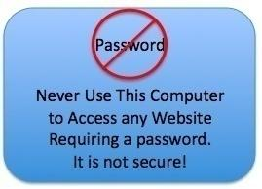
Public Access Computers
Notes:
PACs give me the same feeling I get when I go into a hospital. I assume they are covered with flesh eating bacteria or MERSA or somethig awful.

Slide 37
Public Access Computers
Staying Safe On This Computer:
  Make Sure You Log Out
  Don’t Access Sensitive Sites
  Beware of the "remember me" option
  Don't send personal or financial information via email or insecure websites
Notes:
PACs give me the same feeling I get when I go into a hospital. I assume they are covered with flesh eating bacteria or MERSA or somethig awful.

Slide 38
Public Access Computers
This Week’s Stay Safe Tips
  Never Trust Email
  Learn About Phishing
  Attend Our Security Class
  Always Check For A Secure Connection
Notes:
PACs give me the same feeling I get when I go into a hospital. I assume they are covered with flesh eating bacteria or MERSA or somethig awful.

Slide 39
What Do We Need To Protect?
Staff Computers
Databases
Printers / Copiers
Website
Servers
Backups
Toasters
Cell Phones
Wi-Fi Routers
Routers
Cell Phones
Tablets
Laptops
Lightbulbs
Your Employees Homes / Phones / etc...?
Notes:
Your website and OPAC
A web environment has four layers that need protection: the Network level, the Application level, the Operating System level and the Database level. Most people think of these layers as being one within the other, like concentric circles. They reason that if they protect the outermost level, the inner levels are automatically protected.
Enforce good passwords
Keep things patched
Use a good IDS

Slide 40
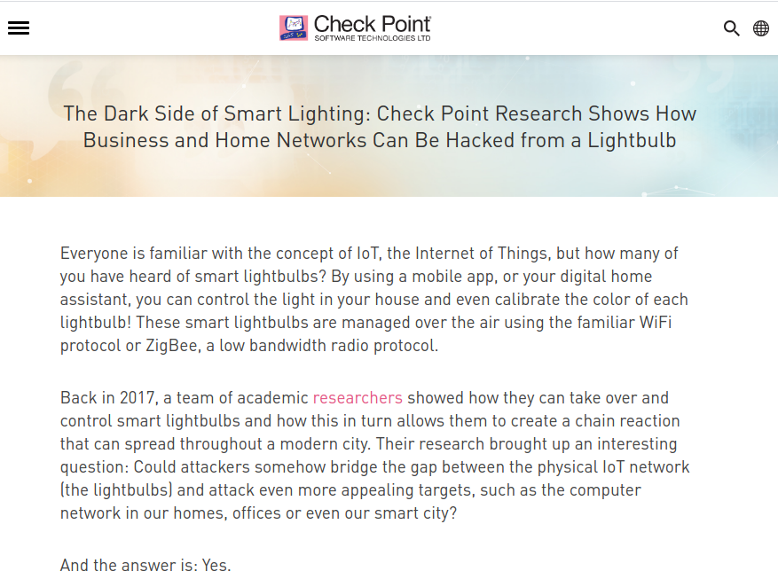
https://blog.checkpoint.com/2020/02/05/the-dark-side-of-smart-lighting-check-point-research-shows-how-business-and-home-networks-can-be-hacked-from-a-lightbulb/

Slide 41
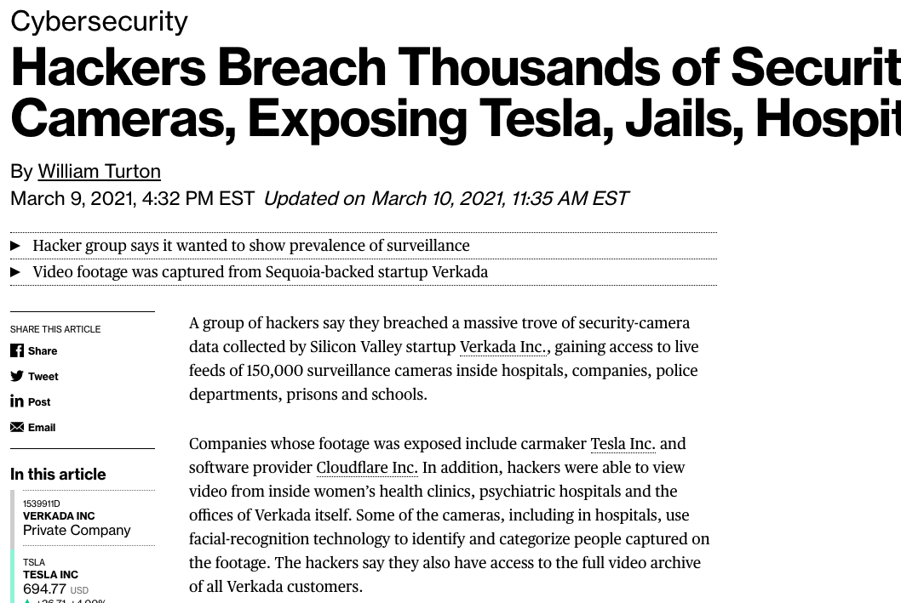
https://www.bloomberg.com/news/articles/2021-03-09/hackers-expose-tesla-jails-in-breach-of-150-000-security-cams

Slide 42
Remote Work / Working From Home
Thanks 2020!
Working from home means that employees:
Will need to be able to access systems that were intended for internal use only
Will heavily use video conferencing platforms
Assess
How Are Your Users Working Remotely?
What Devices Are They Using?
What Software Are They Using?
How Do They Connect?
Do They Manage Sensitive or Protected Data?
Do They Need Access to Specialized Tools or Line of Business Applications?

Slide 43
Remote Work / Working From Home
Thanks 2020!
Secure your identities
2FA
conditional access
impossible travel - contextually aware
new devices - contextually aware
disabling legacy authentication
Time limits
Permissions
SSO
Secure your devices
Updates
Passwords
Settings
VPN
Secure your data
Groups and Users
Data loss prevention
Harden your environments
Updates
Password Managers
Settings
Training

Slide 44
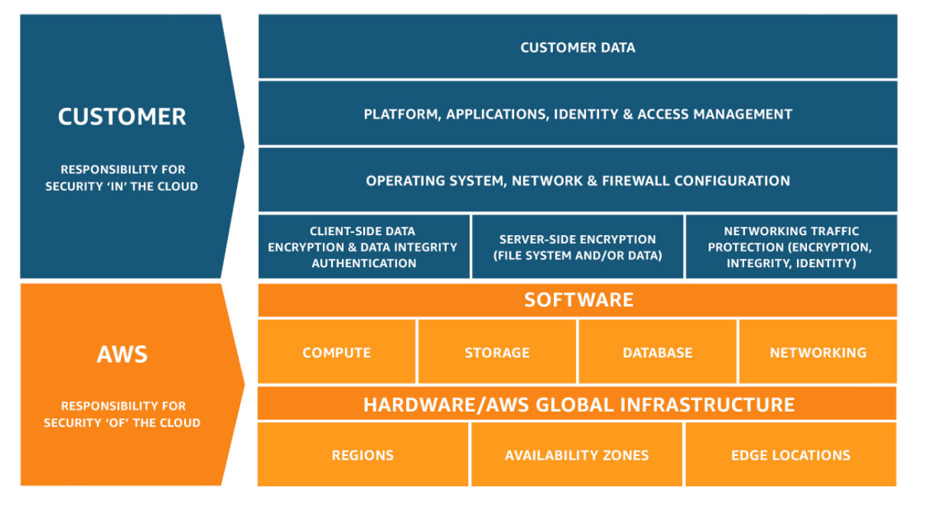
The Cloud
https://aws.amazon.com/compliance/shared-responsibility-model/

Slide 45
CSA surveyed 241 experts on security issues in the cloud industry and came up with these top 11 threats:
Data breaches
Misconfiguration and inadequate change control
Lack of cloud security architecture and strategy
Insufficient identity, credential, access, and key management
Account hijacking
Insider threat
Insecure interfaces and APIs
Weak control plane
Metastructure and applistructure failures
Limited cloud usage visibility
Abuse and nefarious use of cloud services
https://cloudsecurityalliance.org/press-releases/2020/09/23/cloud-security-alliance-releases-top-threats-to-cloud-computing-egregious-11-deep-dive-articulates-cloud-computing-s-most-significant-issues/

Slide 46
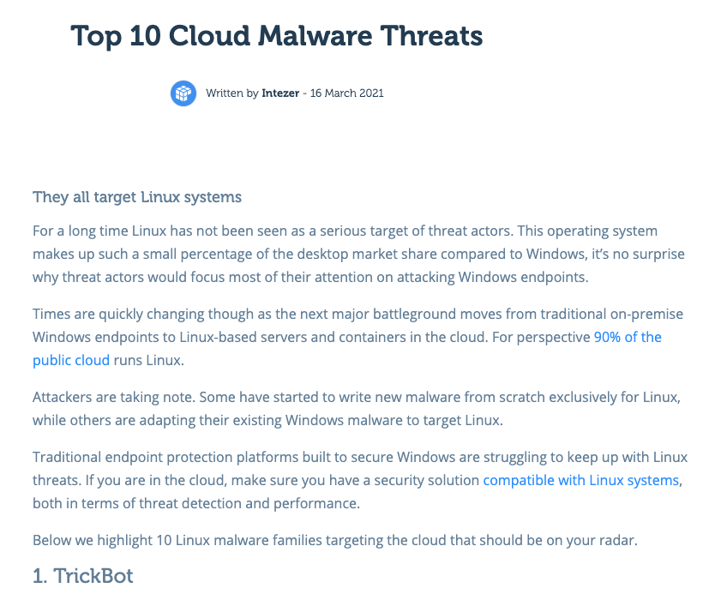
https://www.intezer.com/blog/cloud-security/top-10-cloud-malware-threats/

Slide 47
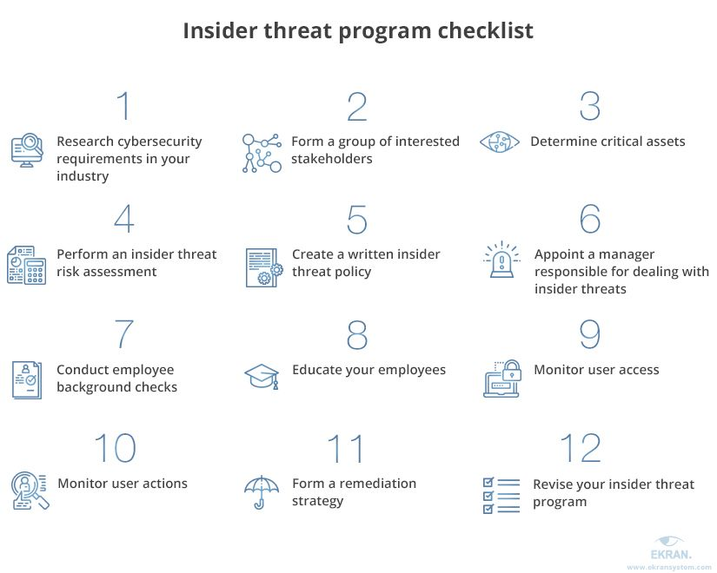
The “Insider Threat” In Libraries
https://www.ekransystem.com/en/blog/insider-threat-program

Slide 48
There are more things to defend than there are resources to defend with
Not every asset in your organization is equally valuable

Slide 49

Locking Down Computers
Patching and Updating
  OS and *ALL* Applications

Slide 50
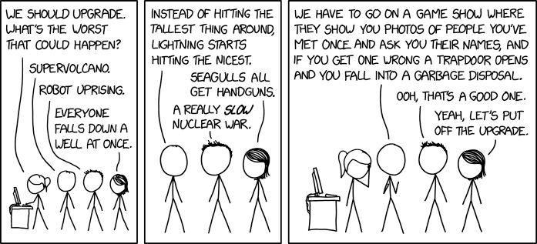

Slide 51
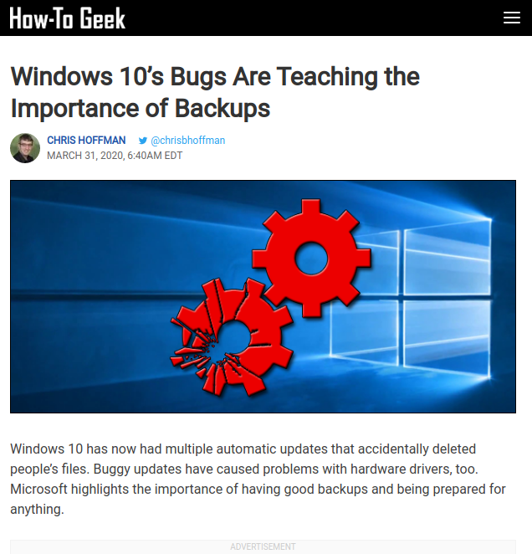

Slide 52

Locking Down Computers
Patching and Updating
  OS and *ALL* Applications
Whitelisting
BIOS passwords
SteadyState / DeepFreeze / SmartShield
Check for suspicious USB additions
Don’t use Windows?

Slide 53
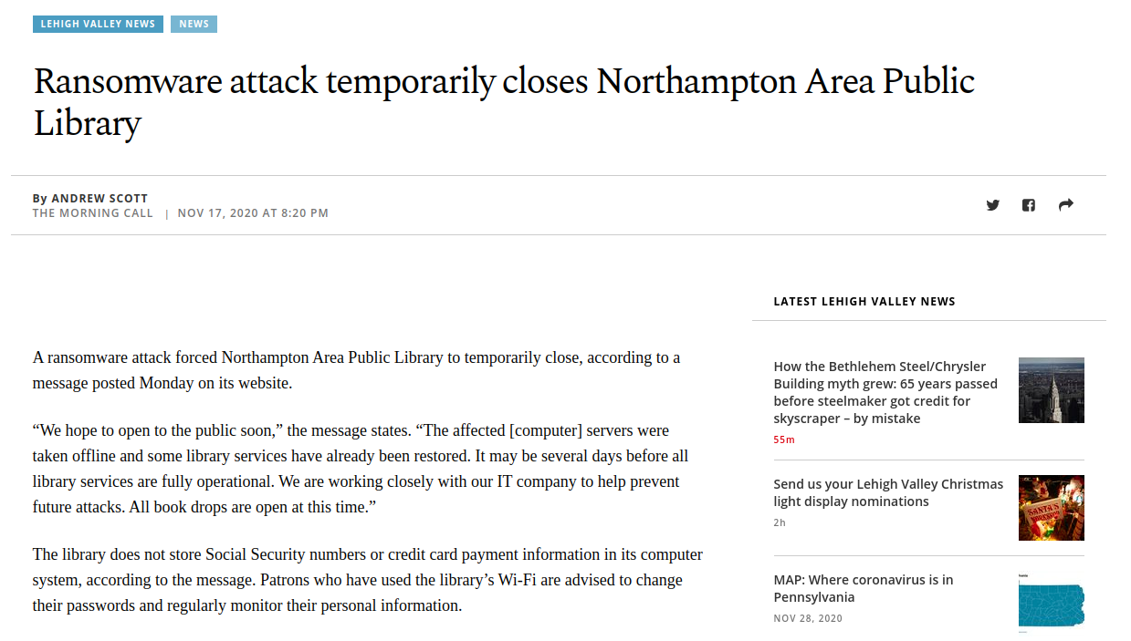

Slide 54
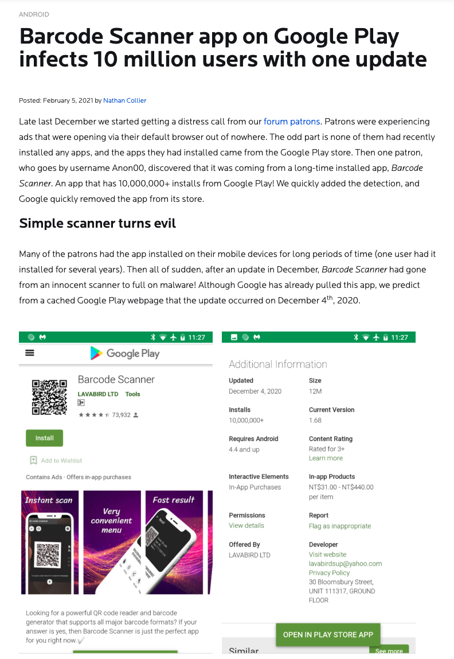
https://blog.malwarebytes.com/android/2021/02/barcode-scanner-app-on-google-play-infects-10-million-users-with-one-update/

Slide 55
Windows security baselines
https://aka.ms/baselines
What are security baselines?
Every organization faces security threats. However, the types of security threats that are of most concern to one organization can be completely different from another organization. For example, an e-commerce company may focus on protecting its Internet-facing web apps, while a hospital may focus on protecting confidential patient information. The one thing that all organizations have in common is a need to keep their apps and devices secure. These devices must be compliant with the security standards (or security baselines) defined by the organization.
A security baseline is a group of Microsoft-recommended configuration settings that explains their security impact. These settings are based on feedback from Microsoft security engineering teams, product groups, partners, and customers.

Slide 56
OSINT
Open Source Intelligence
OSINT is a term that refers to a framework of processes, tools, and techniques for collecting data passively from open or publicly available resources (not to be confused with open-source software). Open source intelligence historically referred to open source information gathering via conventional channels such as newspapers, radio, TV, etc. Nowadays, to extract specific intelligence, we use:
Blogs,
Discussion boards,
Social media,
The dark web (accessible through TOR), and
Deep web (pages not indexed by Google like a people search database).
https://osintframework.com/

Slide 57
Ransomware
&
Extortionware

Slide 58
A massive data breach has hit US Universities including Stanford University, University of California, University of Miami, University of Colorado Boulder, Yeshiva University, Syracuse University, and University of Maryland. Hackers have stolen terabytes of student, prospective student, and employee personal information including transcripts, financial info, mailing addresses, phone numbers, usernames, passwords and Social Security Numbers. These breaches are part of the larger Accellion FTA leak which has affected ~50 organizations. Students who applied to these colleges (or even have an account in the case of UC) are at risk of having their personal and financial information leaked publicly online including their Social Security Numbers. The hackers have sent emails to some victims. If you receive one of these emails, do not click the attached link unless you understand how to use Tor. The hackers are holding the universities at ransom. Unless the universities pay the ransom, the hackers will continue publishing student information.
https://dorper.me/articles/unileak.aspx

Slide 59
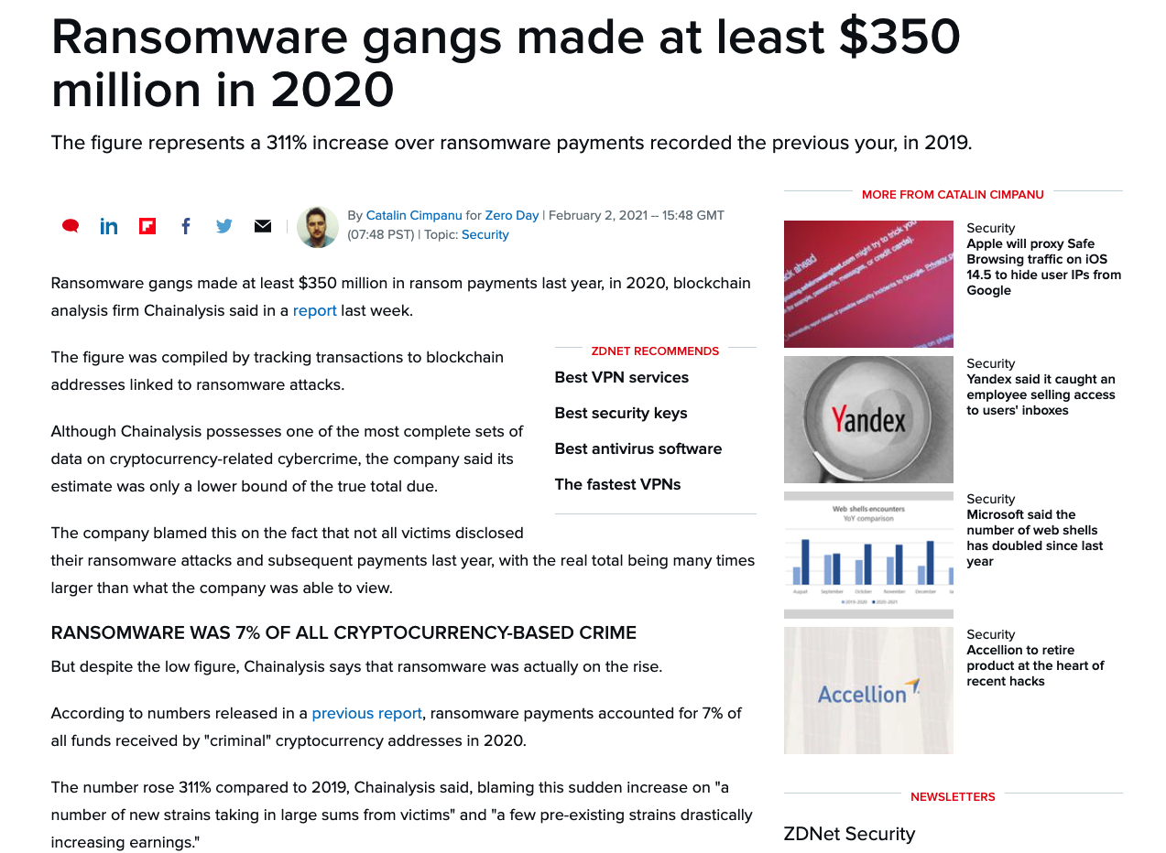

Slide 60
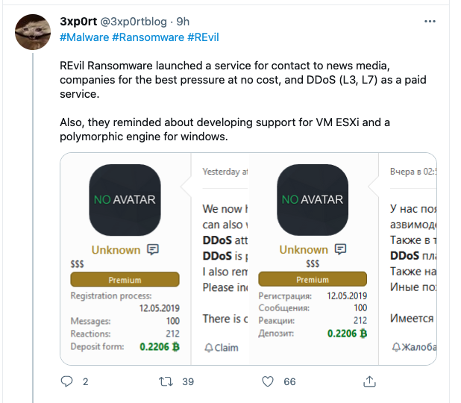
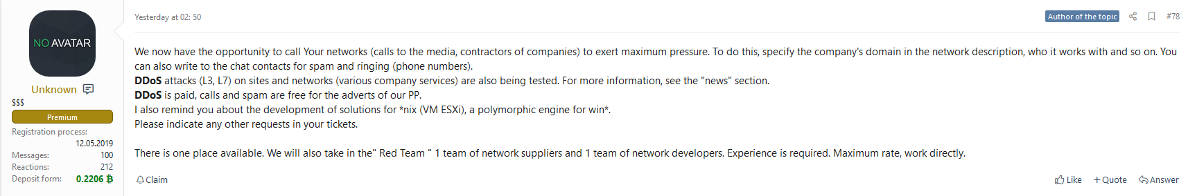

Slide 61
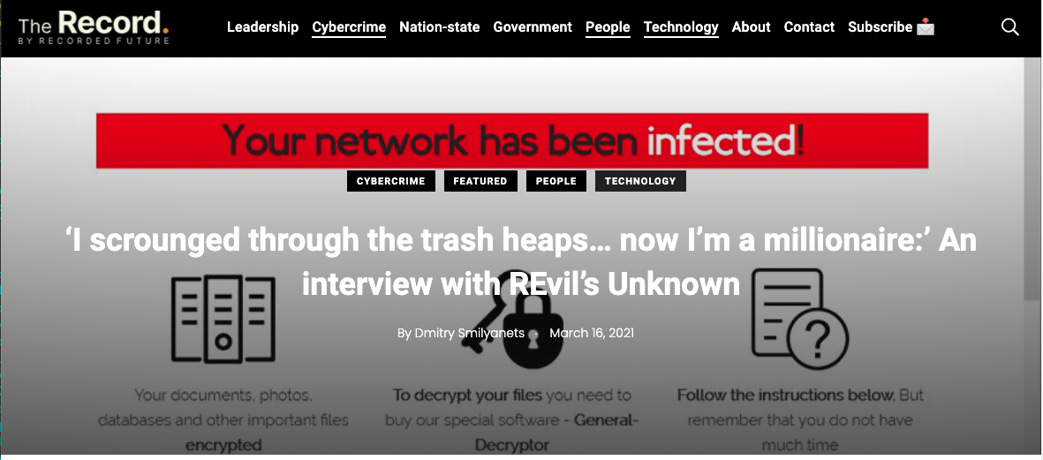
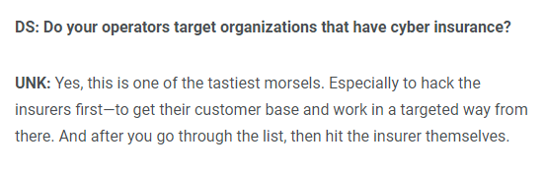
https://therecord.media/i-scrounged-through-the-trash-heaps-now-im-a-millionaire-an-interview-with-revils-unknown/

Slide 62
Never get into a position where you have to pay
Two different types of backups
Mulitple network segments
Virtualizing local servers can be better than bare metal?
Remember, backups cover system critical processes as well.
How do you do something with no computers? Backups for processes, how do you do it manually.

Slide 63
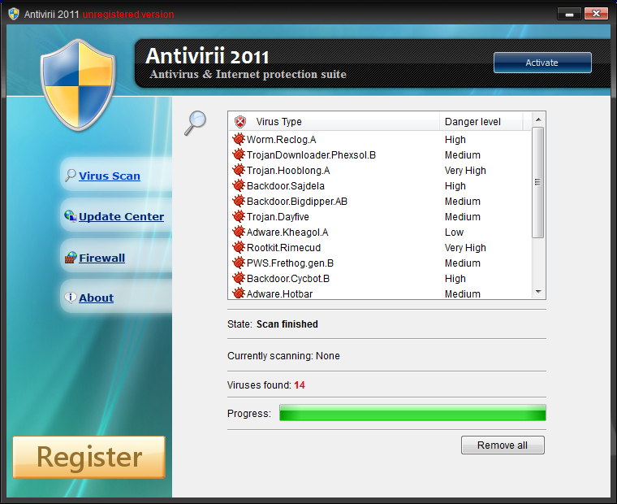
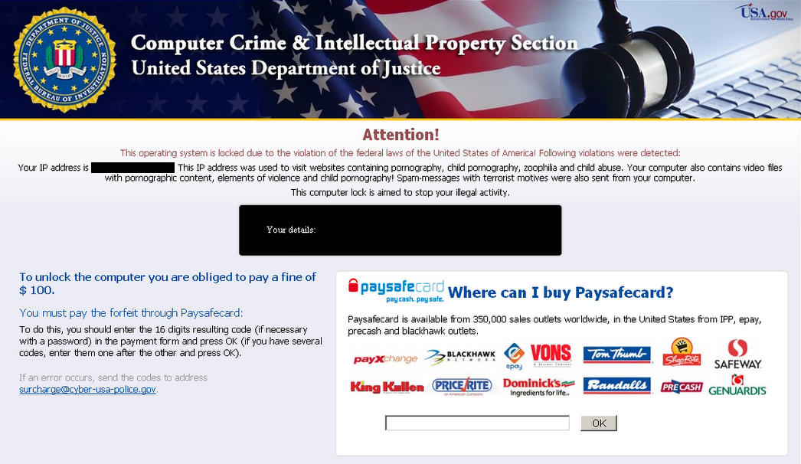
The Good Ol’ Days

Slide 64
Ransomware is commonly deployed across an environment in two ways:
1. Manual propagation by a threat actor after they have penetrated an environment and have administrator-level privileges broadly across the environment:
• Manually run encryptors on targeted systems.
• Deploy encryptors across the environment using Windows batch files (mount C$ shares, copy the encryptor, and execute it with the Microsoft PsExec tool).
• Deploy encryptors with Microsoft Group Policy Objects (GPOs).
• Deploy encryptors with existing software deployment tools utilized by the victim organization.
2. Automated propagation:
• Credential or Windows token extraction from disk or memory.
• Trust relationships between systems — and leveraging methods such as Windows Management Instrumentation (WMI), SMB, or PsExec to bind to systems and execute payloads.
• Unpatched exploitation methods (e.g., EternalBlue — addressed via Microsoft Security Bulletin MS17-010)

Slide 65
Targets of ransomware attacks
There are several reasons attackers first choose what kind of organizations they want to target with ransomware:
Easy to evade defense. Universities, small companies that have small security teams are an easy target. File sharing and an extensive database make the penetration simple for attackers.
Possibility of a quick payment. Some organizations are forced to pay a ransom quickly. Government agencies or medical facilities often need immediate access to their data. Law firms and other organizations with sensitive data usually want to keep a compromise a secret.

Slide 66
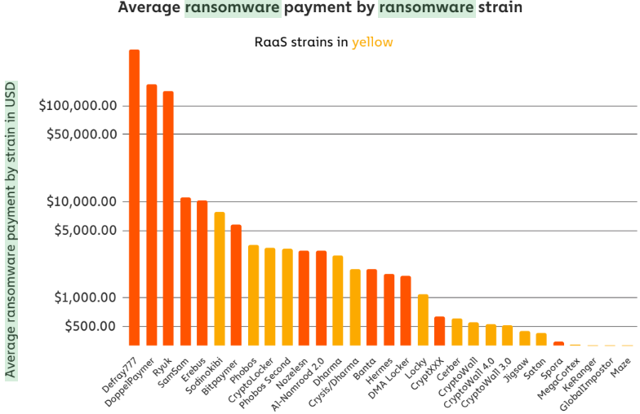
https://krebsonsecurity.com/wp-content/uploads/2020/06/raas-avgprice.png

Slide 67
The Hidden Costs
Opportunity Costs
System Downtime
Reduced Efficiency
Brand Damage & Loss of Trust
IP Theft
Incident REsponse
Outside Help
Insurance
Employee and Patron Moral

Slide 68
The obvious costs
Paying the ransom doubles the cost of dealing with a ransomware attack.
The average cost to rectify the impacts of the most recent ransomware attack (considering downtime, people time, device cost, network cost, lost opportunity, ransom paid etc.) is US$732,520 for organizations that don’t pay the ransom, rising to US$1,448,458 for organizations that do pay.
https://www.sophos.com/en-us/medialibrary/Gated-Assets/white-papers/sophos-the-state-of-ransomware-2020-wp.pdf

Slide 69
10 Reasons Your Library Is Potentially at Risk of a Ransomware Attack
1. Keeping Legacy Systems on the Infrastructure
2. Having Limited Visibility Into Assets and Their Vulnerabilities
3. Forgetting to Implement System Hardening Policies
4. Relying on Perimeter Protection and Antivirus
5. Keeping a Flat Network Topology
6. Relying on Online Backups
7. Exercising Limited Control Over User Access
8. Waiving Security Monitoring and Analytics
9. Underestimating Security Awareness
10. No Incident Response Plan or a Team to Lead It
https://securityintelligence.com/posts/10-reasons-your-organization-is-potentially-at-risk-of-a-ransomware-attack/

Slide 70
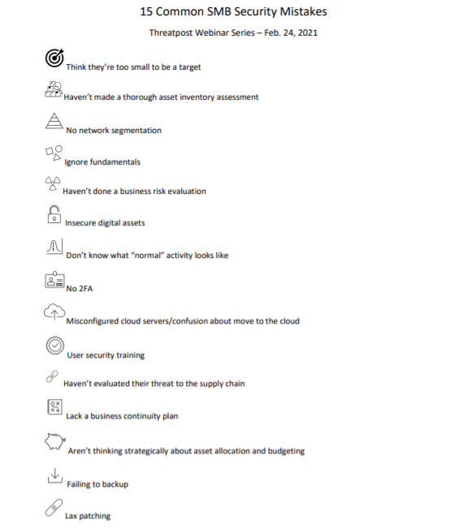
https://threatpost.com/cybersecurity-pitfalls-fixes-smbs/165225/

Slide 71
Ransomware Infection Vector: Internet-Facing Vulnerabilities and Misconfigurations
-Know what you have, especially with public IPs
-Patch/Update
-Configuration/settings
-Kill RDP and SMB
-Settings/Configs
-Asset / Configuration management
Ransomware Infection Vector: Phishing
-Train
-Use good filters
-User a good providers
-Kill Office macros
-2FA
-Kill powershell
Ransomware Infection Vector: Precursor Malware Infection
-Good AV
-Allow Listing
-IDS/IPS
-Least Privilege
-Settings/Configs
-Asset / Configuration management
-Harden your Domain Controllers
Ransomware Infection Vector: Third Parties and Managed Service Providers
-Ask questions
-Know this is a way in
-Keep logs
-Business transaction logging

Slide 72
What to do when ransomware is happening:
Know Who Is Going To Be In Charge
Document EVERYTHING
Pull the plugs ASAP. (train people on this, everyone)
Assume ALL your usernames and passwords are in the wild
Identify the Infection
Make some calls! Vendors, FBI, Insurance, what about the bad guys?
Assess the damage, what's been affected, what is it, what still works, is the virus still growing or hidden, anything have PII
Communicate! staff, board, patrons, public? admins, give regular updates
Do you need to pay? tough call. When you're in this mess the decision can be very hard. Best to avoid being in this position. Maybe you need something back ASAP.
Reinstall your OS and software applications from the source media or the internet. (Make an image of the bad system first)
Restore from backups
Check and double check e.g. Check your email rules on infected machines

Slide 73
Treat the cause, not just the symptoms
Even with the ransomware removed and the system restored from backups, attackers:
may have backdoor access to the network
probably have administrator privileges
could just as easily re-deploy the ransomware if they wanted to

Slide 74
Breach Containment
Creating Situational Awareness
Know what’s going on
Know what normal looks like
strategies and procedures
Reducing the Attack Surface
strong patch management capabilities
vulnerability scanning
Network segmentation
least privilege
IPS/IDS/DLP
shut down a system, disconnect it from a network, disable certain functions)

Slide 75
Protect backups from ransomware!
Put in some roadblocks!
Protect Windows
Most (not all!) ransomware attacks are against Windows, and they spread to other Windows hosts. Try making backups to Linux-based media servers, or MacOS.
Get backups out of the library
Whatever backup solution you choose, copies of backups should be stored in a different location. Send them to the cloud! Cloud object-based storage that can’t be changed. The idea is to get your backups—or at least one copy of your backups—as many hops away from an infected Windows system as they can be. Put them in a provider’s cloud protected by firewall rules, use a different operating system for your backup servers, and write your backups to a different kind of storage. (immutable backup)
Remove file-system access to backups
If your backup system is writing backups to disk, do your best to make sure they are not accessible via a standard file-system directory. For example, the worst possible place to put your backup data is E:\backups. Ransomware products specifically target directories with names like that and will encrypt your backups.

Slide 76
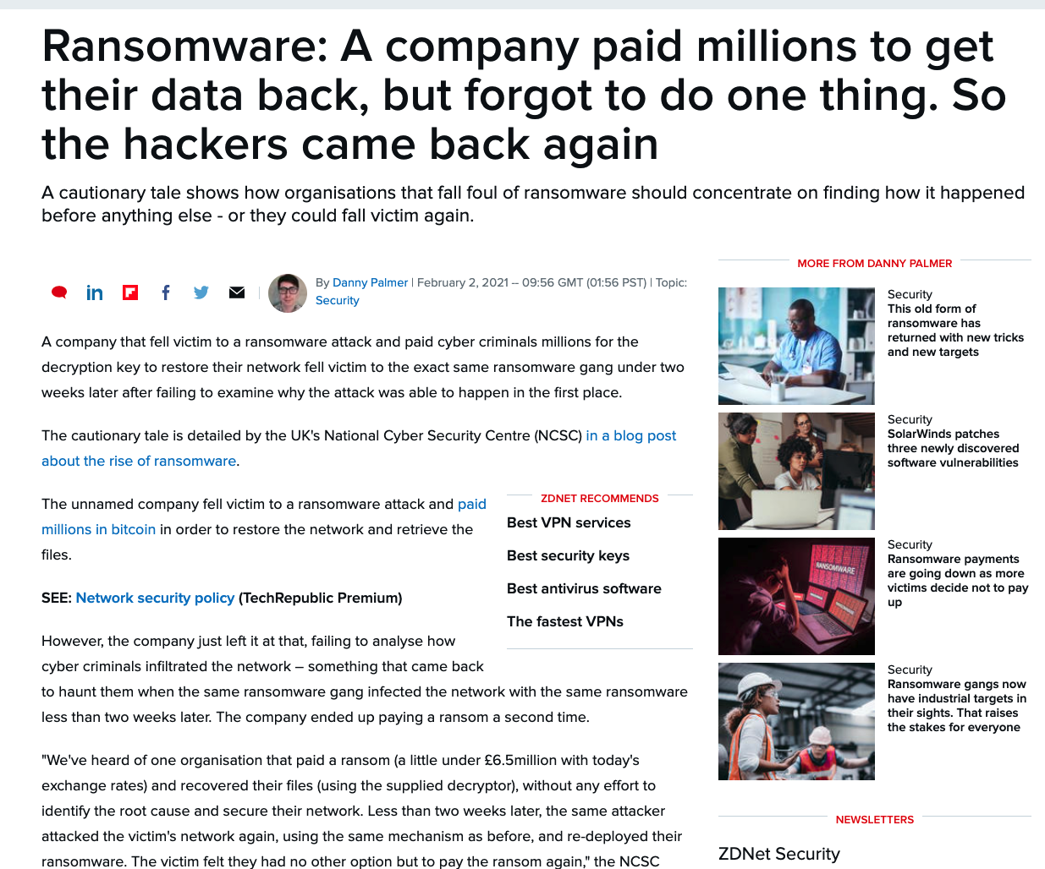
https://www.zdnet.com/article/ransomware-this-is-the-first-thing-you-should-think-about-if-you-fall-victim-to-an-attack/

Slide 77
A key cog in this growing operation is the interdependency between those who specialize in selling access to compromised systems or stolen information, and those looking to launch ransomware attacks.
Data gathered by Intel 471 points to a pattern in numerous ransomware attacks that have occurred in the past 18 months: Criminals in underground forums will advertise access to various breached organizations, and quickly turn to sell access to the highest bidder or strike a deal with an ransomware affiliate in order to share in any profits pulled from a successful payment.
These partnerships have resulted in a flourishing submarket, where access to corporate networks is sold for six-figure sums directly or via a partnership and cut of paid ransoms.
The compromised credentials are mostly obtained through attackers abusing flaws or security shortcomings in virtual private networks or remote desktop protocol endpoints, which provides the initial entry point into enterprise networks. Additionally, credential information can come from logs tied to infostealer malware, password spraying or other credential marketplaces in the criminal underground.
https://intel471.com/blog/ransomware-attack-access-merchants-infostealer-escrow-service/

Slide 78
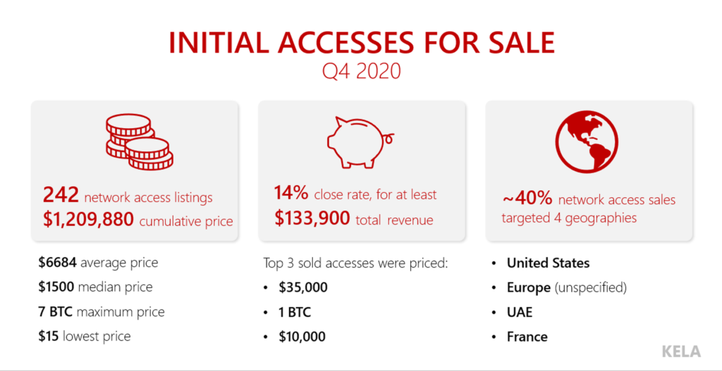
https://ke-la.com/1-million-is-just-the-beginning-q4-2020-in-network-access-sales/

Slide 79
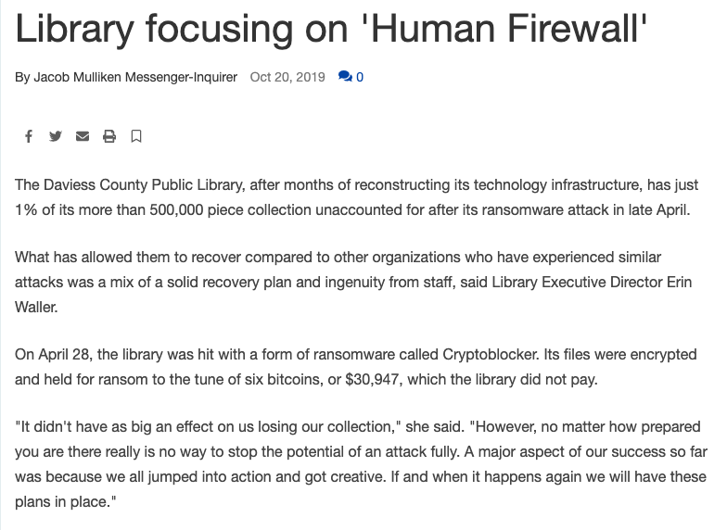

Slide 80
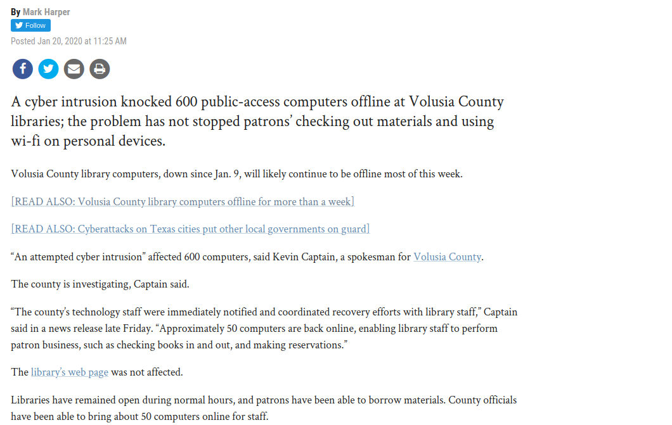

Slide 81
Regular Volusia County Library users say they haven't been able to log onto the public computers since Jan. 8.
Lucinda Colee, director of library services, acknowledged the outage on Thursday, but would not discuss specifics, referring a questions instead to a community information director. Kevin Captain has only said he is "working on your request." Neither immediately responded to messages left on Friday.
Users say they have gotten little information, as well. Nothing is posted on the library's web page.
A librarian and her supervisor at City Island also referred all questions to Colee and simply said the outage is an "IT issue."
One, Marla Orlowski of Edgewater, said Colee returned her call and informed her the computers are out systemwide and might not be working until late next week.
Colee told her Volusia has reciprocal agreements with Flagler, Lake and Brevard counties, where Volusia library users can access materials and computers.
Ben DiGiovanni, a New Smyrna Beach resident, said he doesn't have internet access at home.
"So if I need to do something online, like ... I was looking to do something with my car insurance, the only other access I have is through my phone," DiGiovanni said. "It's much easier to use a desktop."
He said he's visited both the DeLand and New Smyrna Beach branches to no avail.
"It's a little upsetting," said Susan Griggs of Holly Hill. "Those computers are busy most of the time I go there. There are an awful lot of people who depend on these computers."

Slide 82
Email Threats
Business Email Compromise (BEC)
Phishing
Spam

Slide 83
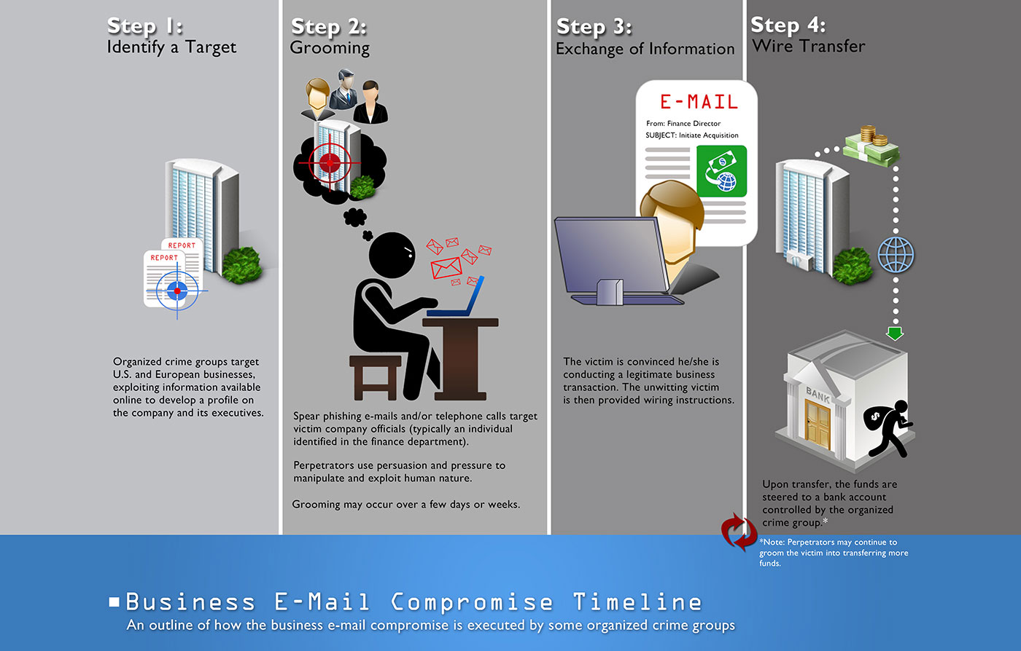
BEC: Business Email Compromise
LEC: Librarian Email Compromise

Slide 84
Watch out for email messages that have subjects containing words like…
request, payment, transfer, and urgent, among others.
5 Common types of BEC scams:
The Bogus Invoice Scheme- Attackers pretend to be known suppliers requesting fund transfers for payments to an account owned by fraudsters.
CEO Fraud - Attackers pose as the company CEO or any executive and send an email to employees in finance, requesting them to transfer money to the account they control.
Account Compromise - An executive or employee’s email account is hacked and used to request invoice payments to vendors listed in their email contacts. Payments are then sent to fraudulent bank accounts.
Attorney Impersonation - Attackers pretend to be a lawyer or someone from the law firm supposedly in charge of crucial and confidential matters.
Data Theft – Employees under HR and bookkeeping are targeted to obtain personally identifiable information (PII) or tax statements of employees and executives. Such data can be used for future attacks.
Watch those forwarding rules in Outlook!

Slide 85
Hit the IC3 Complaint Referral Form ASAP! (https://bec.ic3.gov/)
    include as much detail as possible. What was the account the scammer requested? What was the name used for the account wire? What were the other names of companies involved? Phone numbers called, email accounts used, URL’s visited? Did they send you an invoice, and if so, do you have the original copy?
Report all accounts
    Email
    Social Media
    Domains (maybe)
Assume You’ve Lost Control
    Assume inbox = fully compromised
      all emails
      Rules
      Passwords
      Everything
A Complete BEC recovery guide: https://github.com/PwC-IR/Business-Email-Compromise-Guide

Slide 86
Microsoft 365 Defender Recommendations
Educate end users
Configure Office 365 email filtering settings to ensure blocking of phishing & spoofed emails,
Set Office 365 to recheck links on click and delete sent mail to benefit from newly acquired threat intelligence.
Disallow macros or allow only macros from trusted locations. See security baselines for Office and Office 365.
Turn on AMSI for Office VBA.
Check perimeter firewall and proxy to restrict servers from making arbitrary connections to the internet to browse or download files.
Turn on network protection to block connections to malicious domains and IP addresses.
Turning on attack surface reduction rules, including rules that can block advanced macro activity, executable content, process creation, and process injection initiated by Office applications, also significantly improves defenses. The following rules are especially useful:
  Block all Office applications from creating child processes
  Block Office applications from creating executable content
  Block Office applications from injecting code into other processes
  Block Win32 API calls from Office macros
  Block executable files from running unless they meet a prevalence, age, or trusted list criterion
  Block Javascript or VBScript from launching downloaded executable content
  Block execution of potentially obfuscated scripts
  Block executable content from email client and webmail
https://www.microsoft.com/security/blog/2021/02/01/what-tracking-an-attacker-email-infrastructure-tells-us-about-persistent-cybercriminal-operations/

